Slide 1
Hawassa City Traffic Control and Management System

Slide 2
Introduction
RTA
Founded in 1967 as Road Transport Administration
1976 – Restructured as RTA
Ensure the provision of a modern, integrated and safe Road transport services
Control driver’s license
Register Vehicle information

Slide 3
General Objective
Develop
user friendly,
easily accessible
centralized
Computerized Traffic Control and Management System
Notes:
To change the manual system into computerized System and
develop a user friendly system that avoids the need for unnecessary physical interaction with the document

Slide 4
Specific Objective
Register Driver and vehicle
Register Employee and Traffic police
Register Accident Information
To check whether driver has license or not using android mobile app
Notes:
To change the manual system into computerized System and
develop a user friendly system that avoids the need for unnecessary physical interaction with the document

Slide 5
Scope
Applied on Hawassa city Transport Authority
Store and Provide information about Traffic Polices, Drivers, Vehicles
Users
Traffic Polices
RTA Employee
Drivers

Slide 6
Coding standards
coding standards document tells developers how they must write their code
Notes:
an important factor for achieving a high code quality
A coding standards document tells developers how they must write their code
A common visual style, naming convention and other technical setting allow us to produce a homogeneous code which is easy to read and maintain

Slide 7
Road Transport Authority
Employee Registration and Login
Administrator Registration and Login
Vehicle Registration
Driver Registration and Login
Vehicle Detail Information
Driver Detail Information
Generate Report
Forum Discussion
Log File
User Manual

Slide 8
Traffic Police
Traffic Police Administrator Registration and Login
Field Traffic Police Registration and Login
Accident Registration
Driver Punishment
Generate Report
Forum Discussion
Log File
User Manual

Slide 9
Naming standards
Notes:
Modules are named according to their function.
In each Module there may be a lot of variable, function, Class, interface, structure and also user defined data type and user defined object.
that any developer or programmer can understand and maintain the code when necessary with less time.

Slide 10

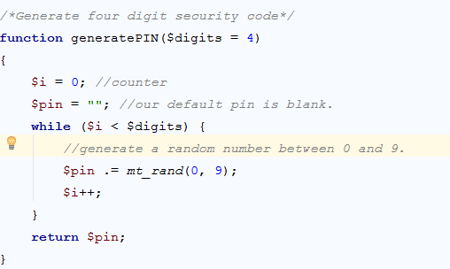
Naming function

Slide 11
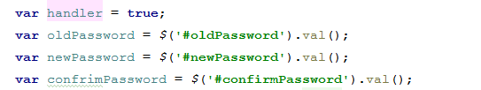
Variable Naming

Slide 12
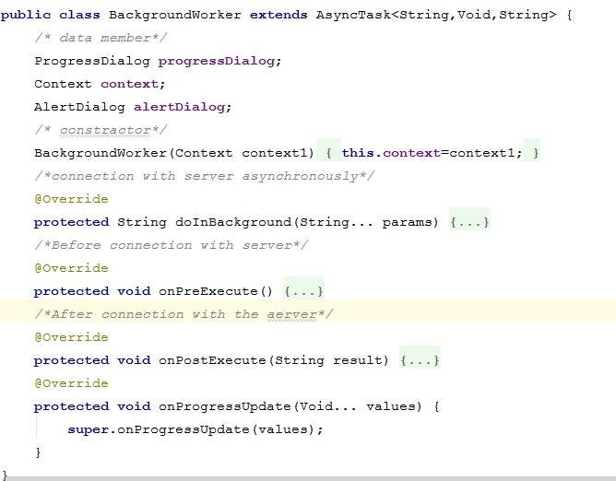
Naming Class

Slide 13
Naming Package

Slide 14
Major Algorithms

Slide 15
PSEUDO CODE FOR LOGIN
Step
Method name =Login
Begin
Variables: - Username, password
Read username & password
Send username and password to the server and check against database
If user name and password are correct, check user account status
If user account status is active, create Session ID and set user ID
Session last when the browser is closed.
End if // inner if
Else user is not logged in to the system and display User account deactivated message
Else user is not logged in to the system and display Incorrect user name and password message
End if
END
Notes:
Pseudo code is compact and informal high-level description of a computer programming algorithm that uses the structural conventions of a programming language

Slide 16
Register Driver
Step
Method name =register Driver
Begin
Variables: full name, license number, birthday, level, woreda , kebele , house number, contact, registration place
Read those variables and validate them
If all variables are valid and the required fields are set, then send to the server and store the driver database and create Account for the driver
Else Display the error message for the error field accordingly
End if
END

Slide 17
Logout
Step
Method name: logout
Begin
Variables: - session ID
Destroy session
Redirect to the login Page
End

Slide 18
Testing case

Slide 19
Testing the correctness
Testing the Accuracy
Testing the Performance
Testing the security

Slide 20
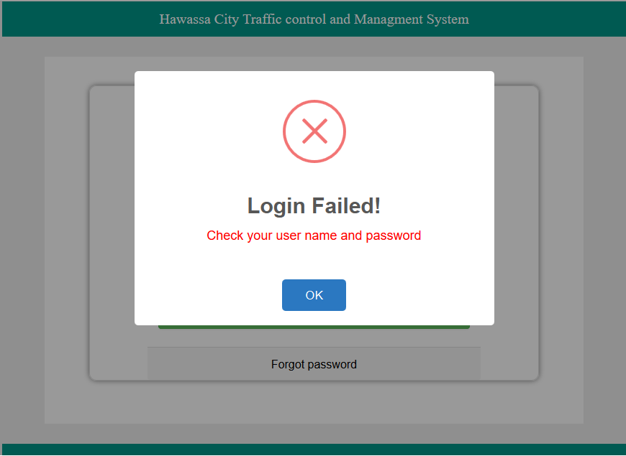

Slide 21
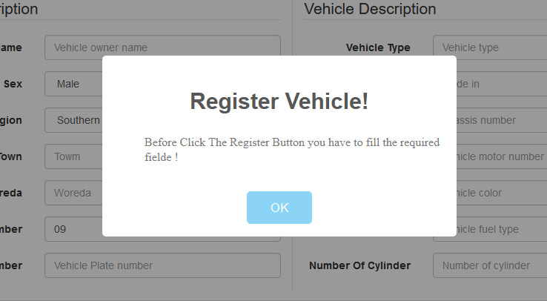
Unit testing

Slide 22
Test report
Error report
Test case report

Slide 23
Test case for login
S No | Test | Input | Expected Output | Actual output
1 | To test whether the loin is done properly or not | Invalid user and password | Display error message | Login successful and redirect to the home page

Slide 24
Test case for send message
S No | Test | Input | Expected Output | Actual output
1 | To test whether the message is sent to the administrator or not | Incorrect message format or empty message | Display Error message | Display successful message

Slide 25
User Manual

Slide 26
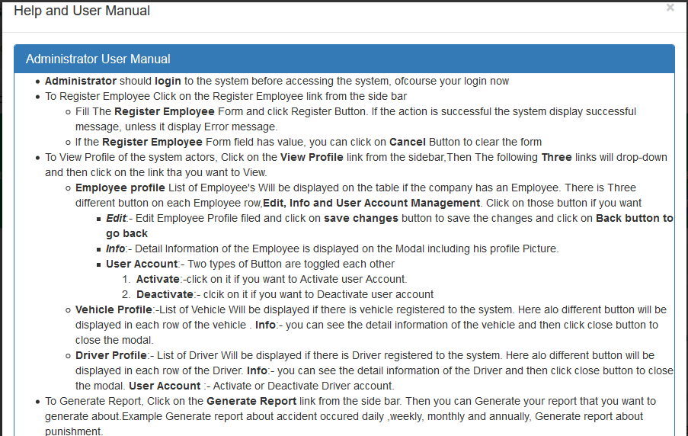
Admn Manual

Slide 27
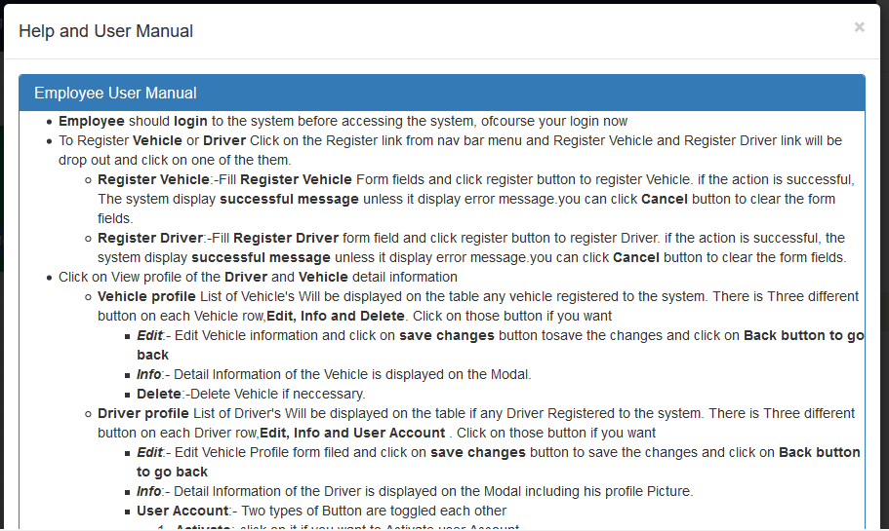
Emp Manual

Slide 28
Thanks

